Slide 1
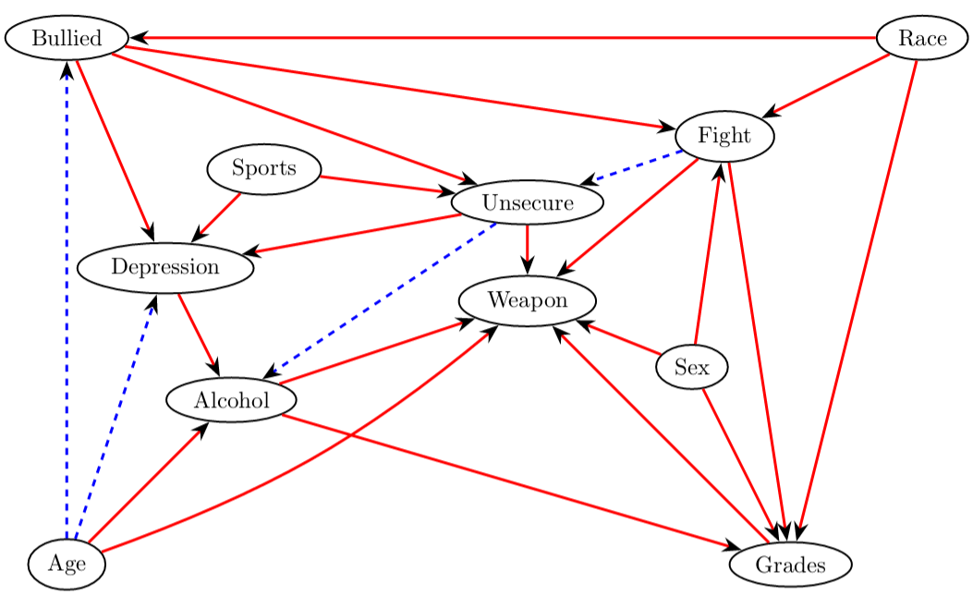
Predicting probability for a given individual to carry a weapon in school

